Slide 1
HPC Presentation
S346410 - S338446 - S336649
Filippo Marangoni, Denis Fabian Filip, Walid Bou Ezz

Slide 2
Content
Problem 1: Systolic array structures for matrix multiplication
Introduction
Solution Description
Experimental Results
Conclusion
Problem 2: Fundamentals of multi-dimensional data processing
Introduction
Solution Description
Experimental Results
Conclusion
Problem 3: Heat Diffusion Simulation in 2D Grid
Introduction
Solution Description
Experimental Results
Conclusion

Slide 3
Problem 1: Systolic array structures for matrix multiplication

Slide 4
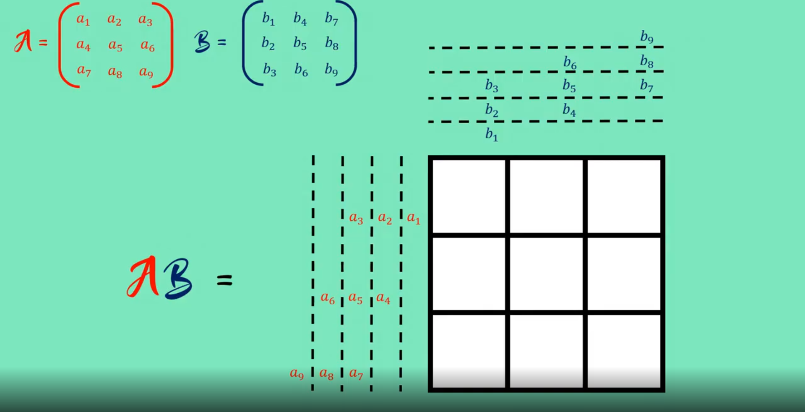
A Visualization is better than lots of words

Slide 5
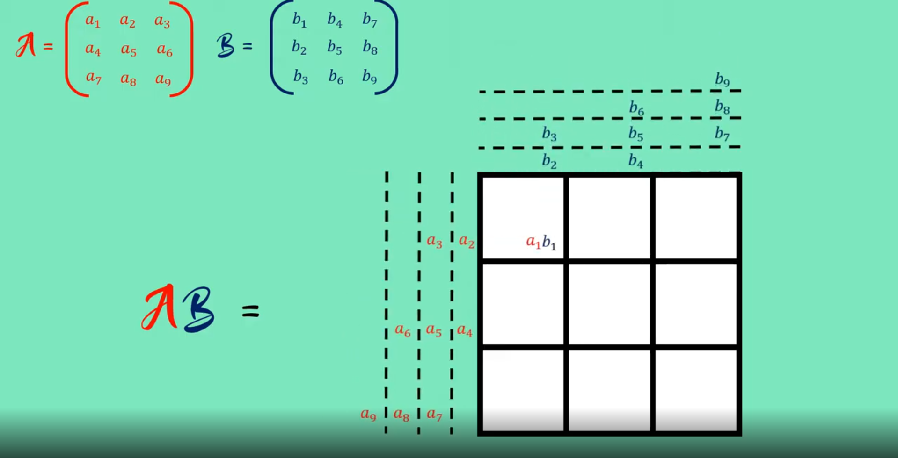
A Visualization is better than lots of words

Slide 6
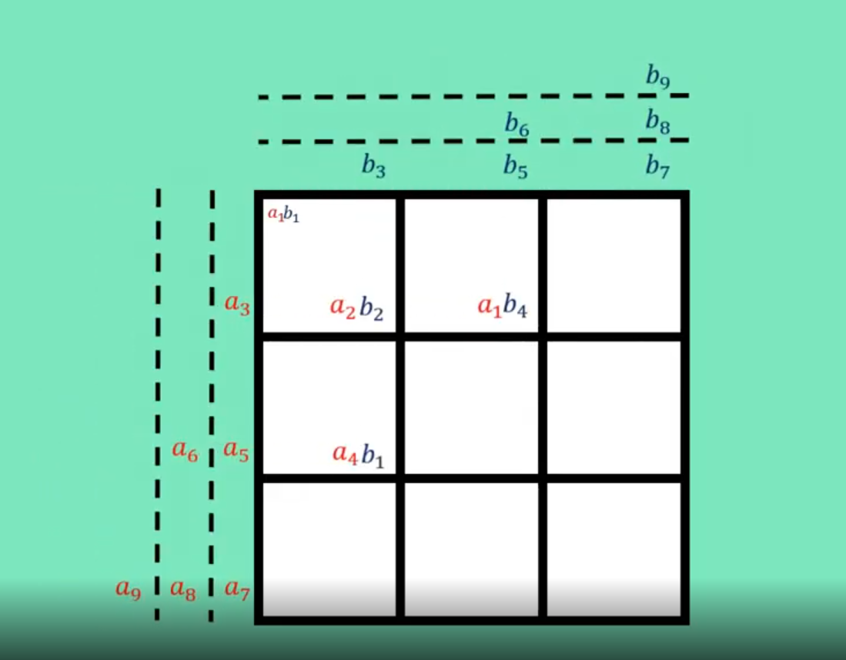
A Visualization is better than lots of words

Slide 7
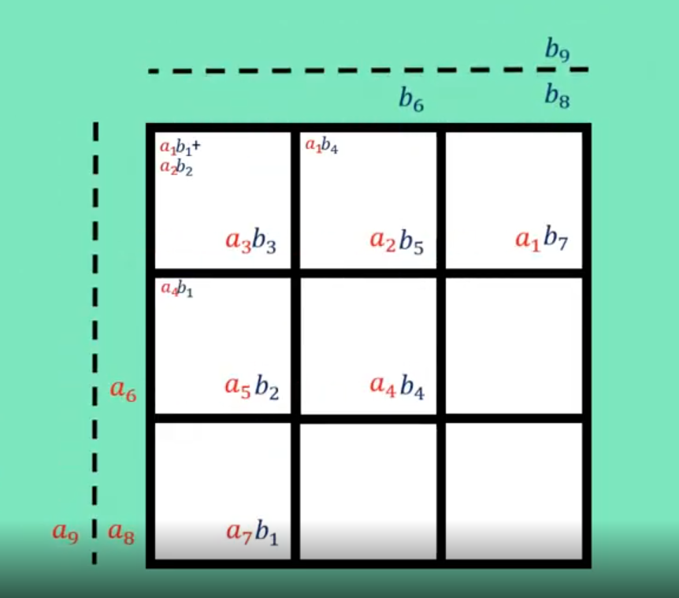
A Visualization is better than lots of words

Slide 8
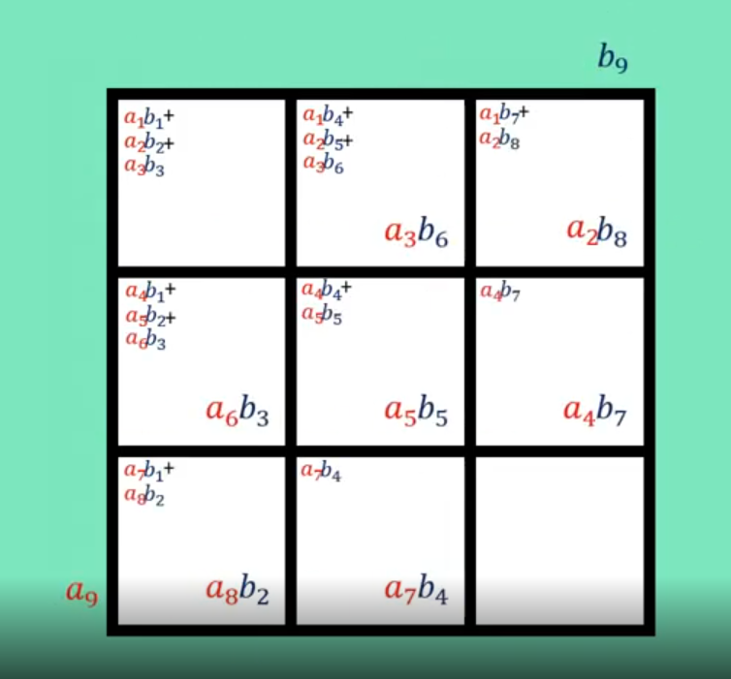
A Visualization is better than lots of words

Slide 9
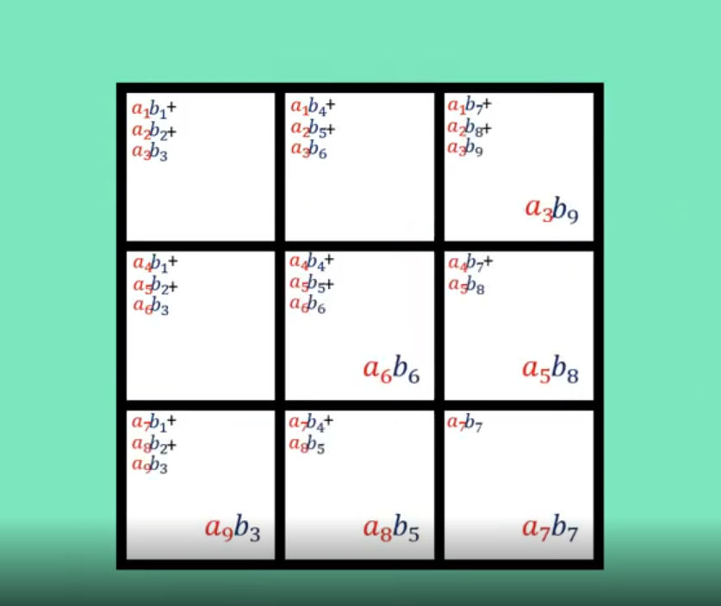
A Visualization is better than lots of words

Slide 10
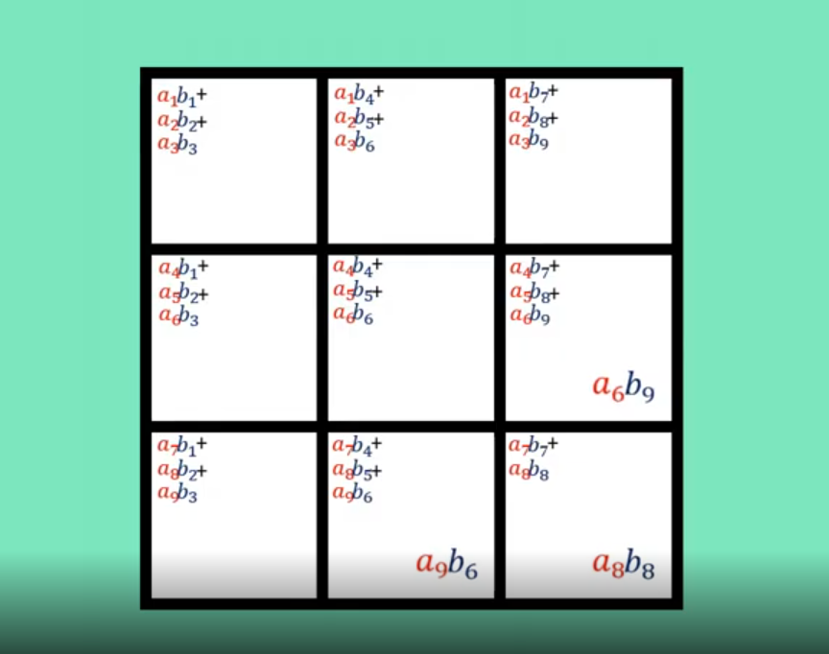
A Visualization is better than lots of words

Slide 11
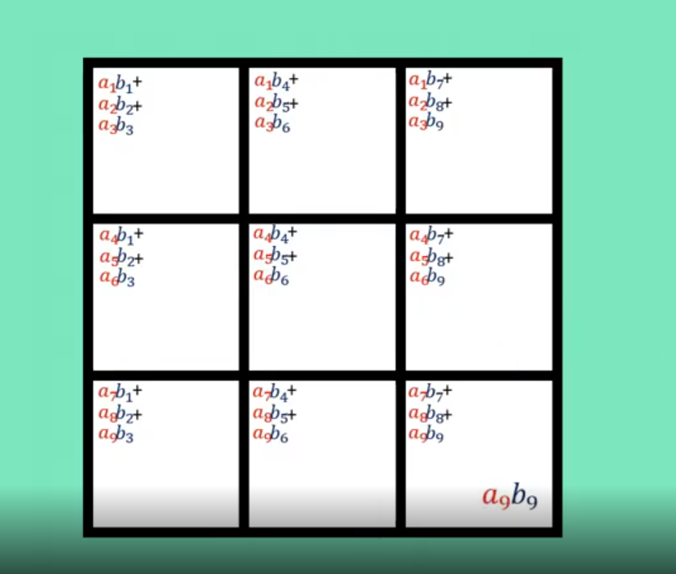
A Visualization is better than lots of words

Slide 12
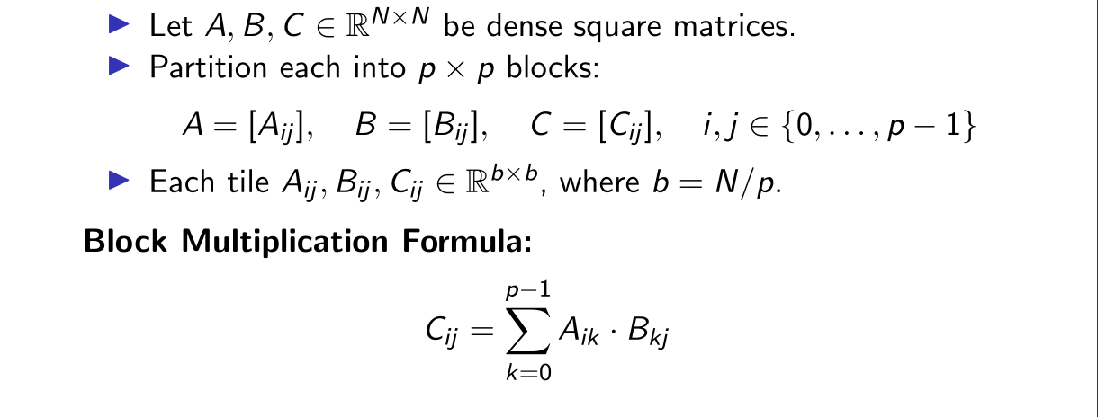
Matrix Partitioning

Slide 13
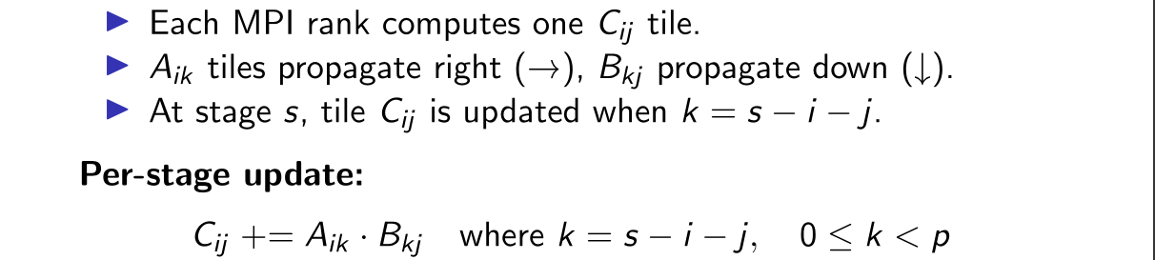
Systolic Interpretation

Slide 14
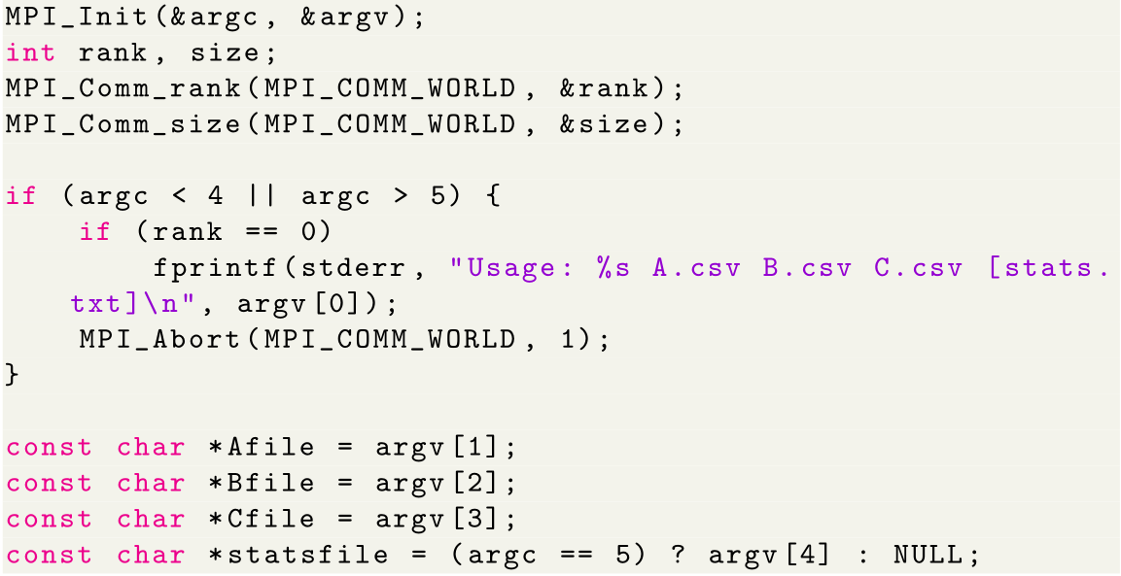
Code Initialization

Slide 15
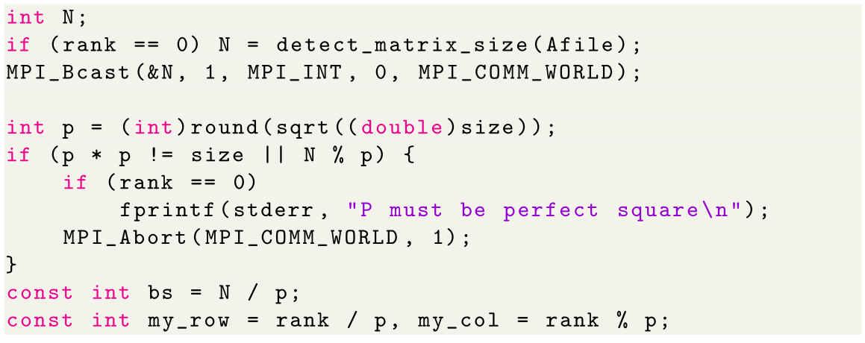
Matrix Discovery and Grid Setup

Slide 16
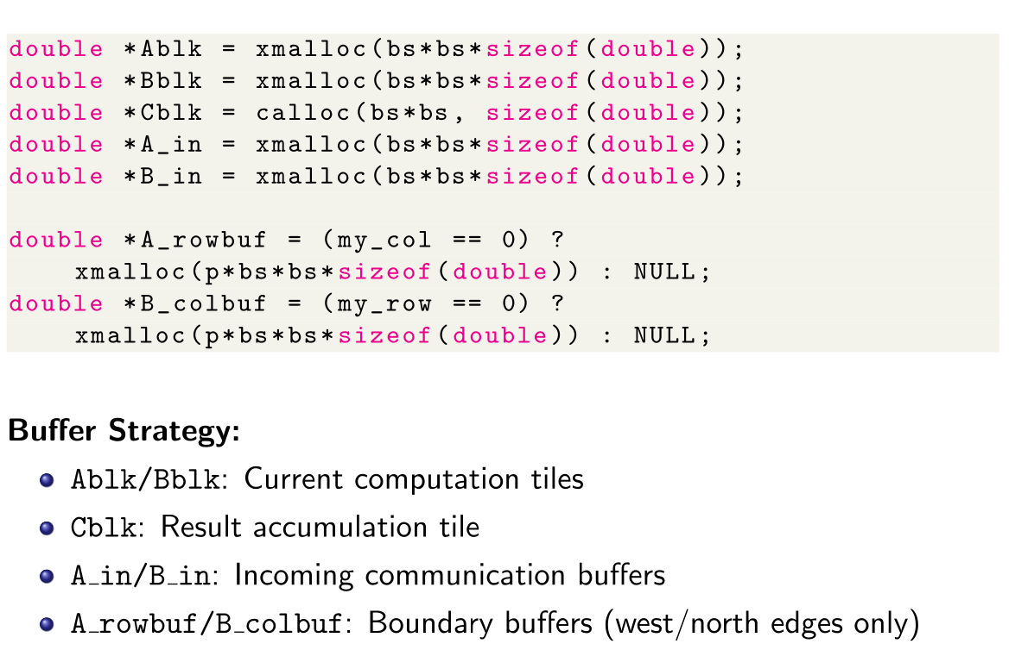
Memory Allocation and Buffering

Slide 17
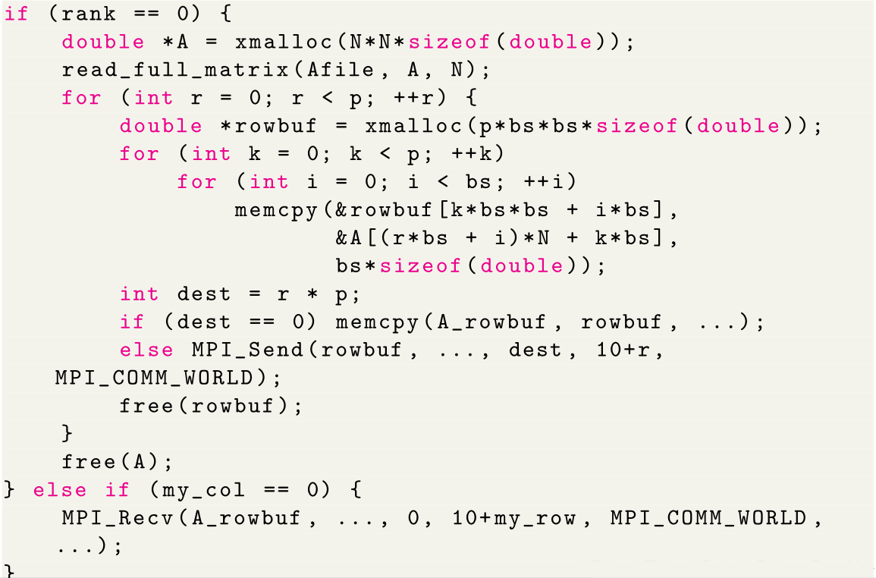
Matrix Distribution Strategy

Slide 18
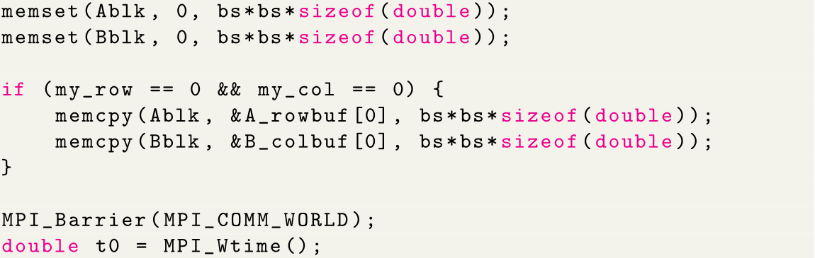
Systolic Pipeline Initialization

Slide 19
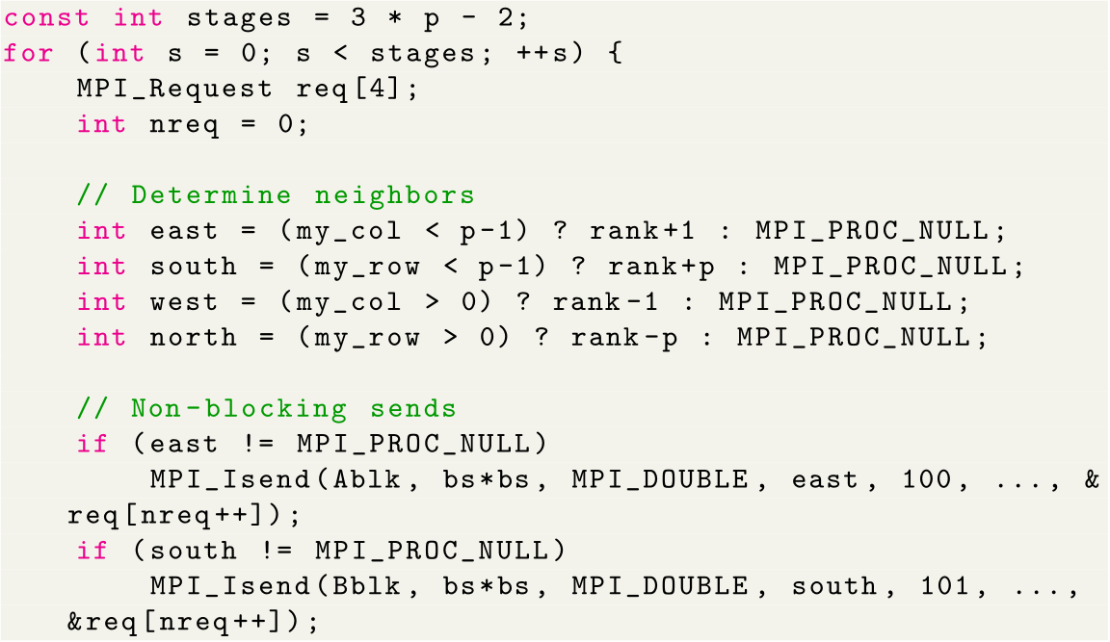
Pipeline Execution

Slide 20
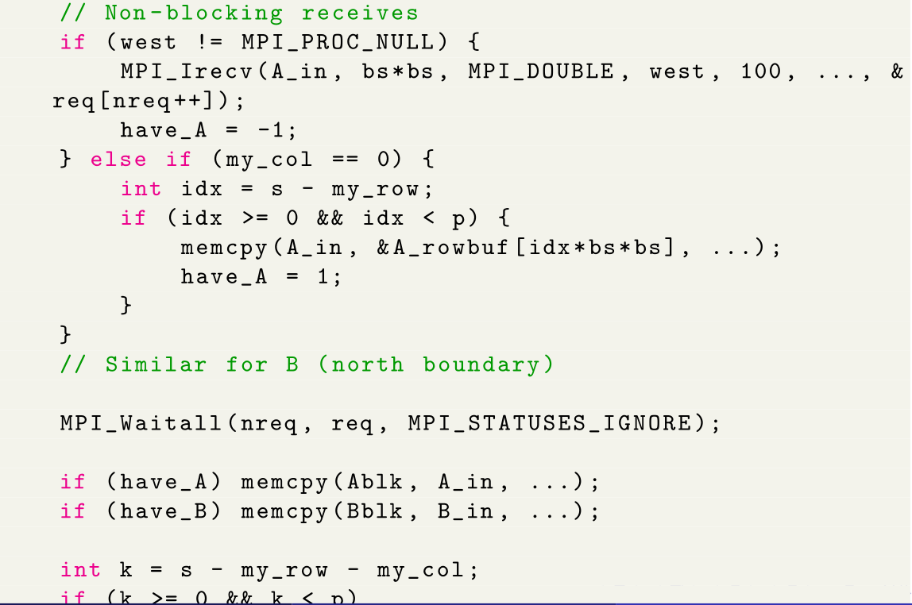
Data Reception and Computation

Slide 21
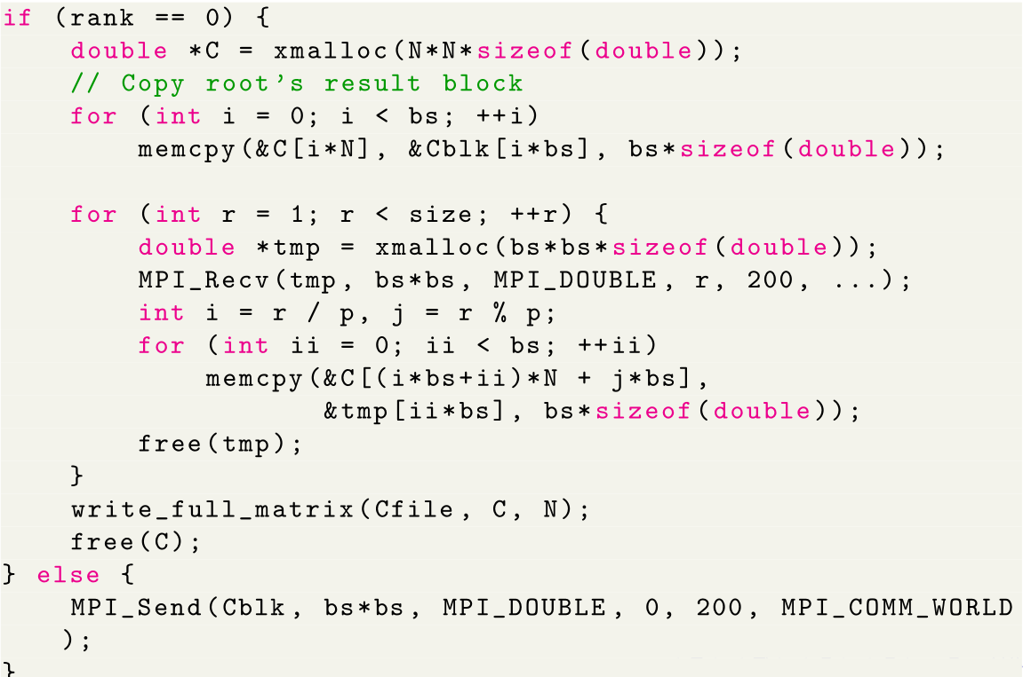
Result Collection

Slide 22
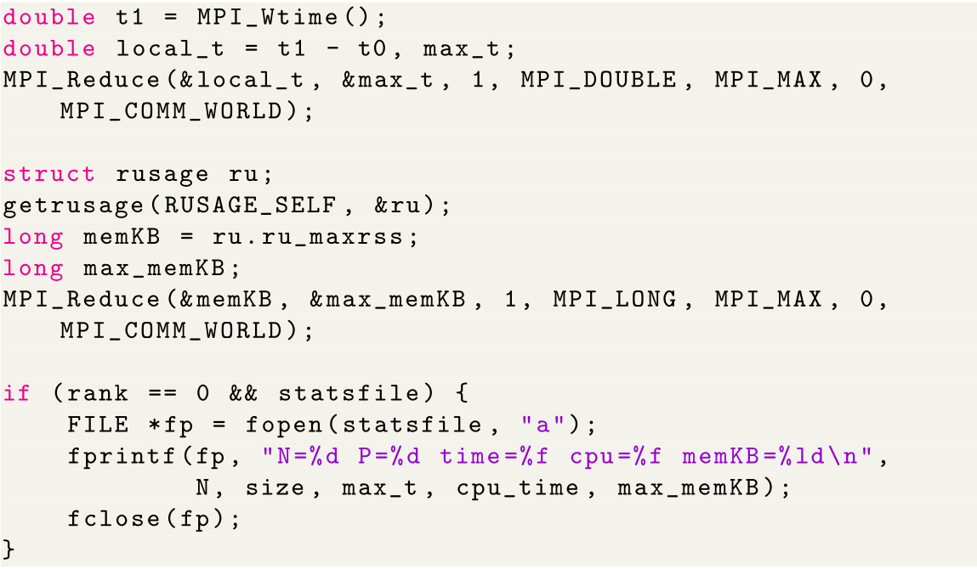
Performance Collection

Slide 23
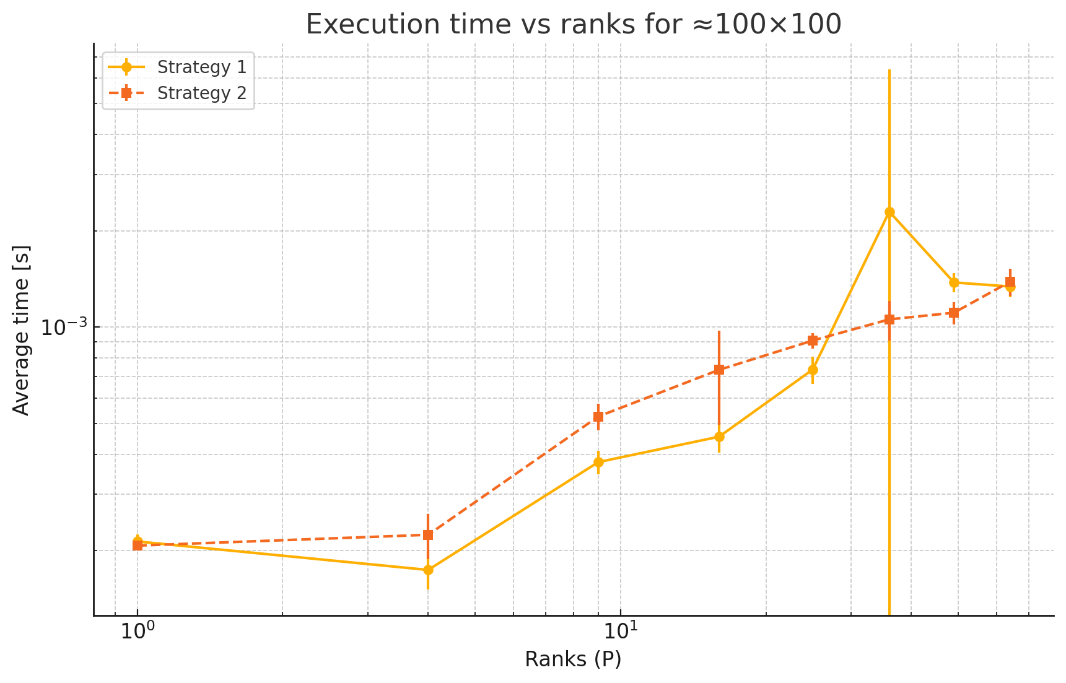
Analysis of the code

Slide 24
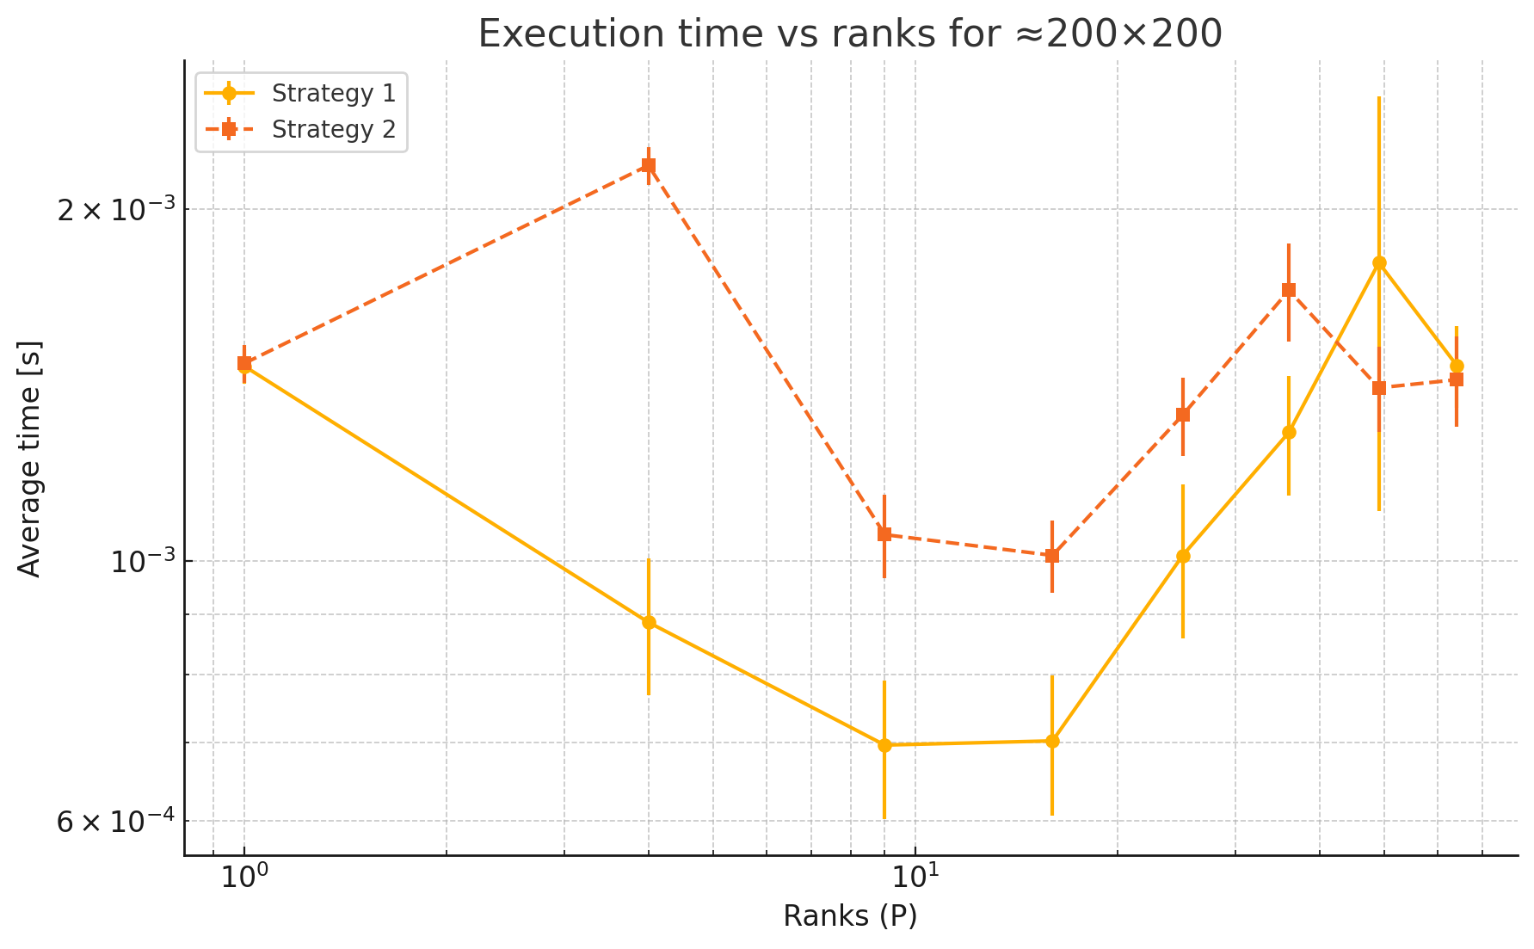
Analysis of the code

Slide 25
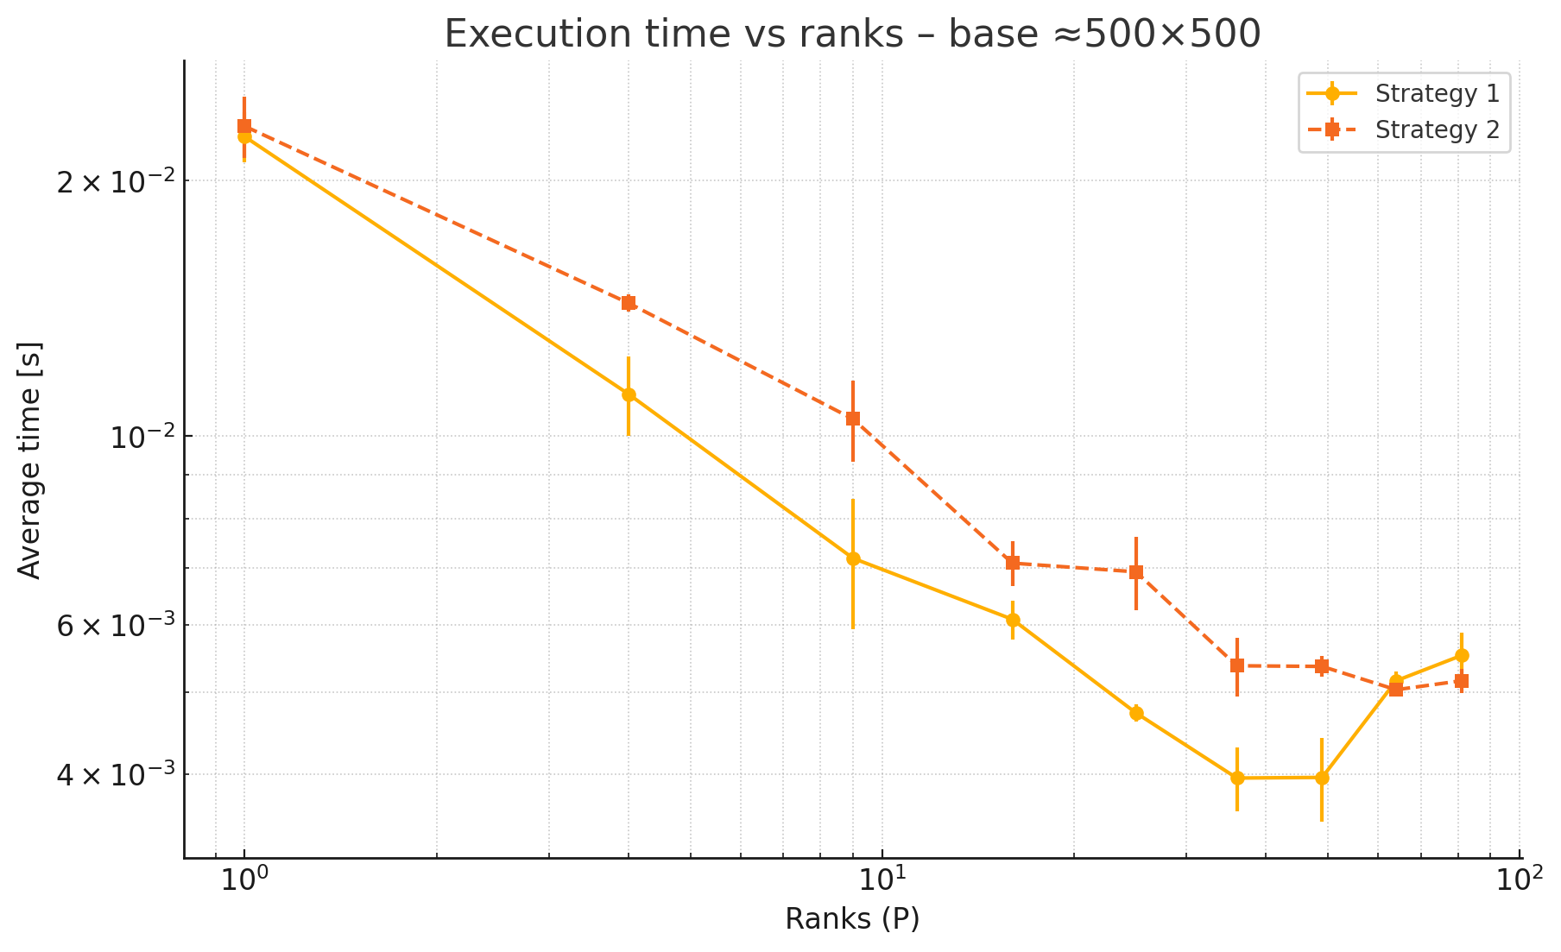
Analysis of the code

Slide 26
Problem 2: Fundamentals of multi-dimensional data processing

Slide 27
What’s a Gaussian Blur (1 color channel for simplicity)
148×1 + | 153×2+ | 158+1+
149×3 + | 158×4 + | 193×3 +
172×1 + | 149×2 + | 128×1
Image’s pixels (simplified)
New value = (1/18)× (9 + )
=159
148 | 153 | 158 | 136 | 128
149 | 158 | 193 | 212 | 124
172 | 149 | 128 | 127 | 168
167 | 204 | 120 | 165 | 145
Kernel Weights
148 | 153 | 158 | 136 | 128
149 | 159 | 193 | 212 | 124
172 | 149 | 128 | 127 | 168
167 | 204 | 120 | 165 | 145
1 | 2 | 1
3 | 4 | 3
1 | 2 | 1

Slide 28
What’s a Gaussian Blur (1 color channel for simplicity)
EACH PIXEL IS HANDLED BY A THREAD
153×1 + | 158×2+ | 136×1+
158×3 + | 193×4 + | 212×3 +
149×1 + | 128×2 + | 127×1
Image’s pixels (simplified)
New value = (1/18)× (9 + )
=168
148 | 153 | 158 | 136 | 128
149 | 158 | 193 | 212 | 124
172 | 149 | 128 | 127 | 168
167 | 204 | 120 | 165 | 145
Kernel Weights
148 | 153 | 158 | 136 | 128
149 | 159 | 168 | 212 | 124
172 | 149 | 128 | 127 | 168
167 | 204 | 120 | 165 | 145
1 | 2 | 1
3 | 4 | 3
1 | 2 | 1

Slide 29
Final result blur image
Handling boundaries using Mirroring
158 | 149 | 158 | 193 | 212 | 124 | 212
153 | 148 | 153 | 158 | 136 | 128 | 136
158 | 149 | 158 | 193 | 212 | 124 | 212
149 | 172 | 149 | 128 | 127 | 168 | 127
204 | 167 | 204 | 120 | 165 | 145 | 165
149 | 172 | 149 | 128 | 127 | 168 | 127
148 | 153 | 158 | 136 | 128
149 | 158 | 193 | 212 | 124
172 | 149 | 128 | 127 | 168
167 | 204 | 120 | 165 | 145
152 | 158 | 167 | 160 | 148
155 | 159 | 168 | 162 | 160
163 | 158 | 150 | 152 | 151
176 | 160 | 147 | 142 | 153
Gaussian blur

Slide 30
Effect of SALT & PEPPER Noise
SALT & PEPPER noise: randomly scattered white and black pixels
148 | 153 | 158 | 136 | 128
149 | 158 | 193 | 212 | 124
172 | 149 | 128 | 127 | 168
167 | 204 | 120 | 165 | 145
148 | 153 | 158 | 255 | 128
149 | 0 | 0 | 212 | 0
255 | 149 | 255 | 127 | 168
167 | 204 | 120 | 0 | 145
Salt & Pepper

Slide 31
Blur image SALT & PEPPER (1 color channel for simplicity)
148 | 153 | 158 | 136 | 128
149 | 158 | 193 | 212 | 124
172 | 149 | 128 | 127 | 168
167 | 204 | 120 | 165 | 145
152 | 158 | 167 | 160 | 148
155 | 159 | 168 | 162 | 160
163 | 158 | 150 | 152 | 151
176 | 160 | 147 | 142 | 153
Gaussian blur
Blurring with vs without the salt and pepper version of the image
148 | 153 | 158 | 255 | 128
149 | 0 | 0 | 212 | 0
255 | 149 | 255 | 127 | 168
167 | 204 | 120 | 0 | 145
117 | 102 | 127 | 151 | 161
111 | 104 | 119 | 129 | 146
164 | 165 | 139 | 137 | 119
195 | 183 | 148 | 119 | 98
S.P. + Gaussian blur

Slide 32


Actual Image Conversions (Inputs)
Initial Image
Image + 90% S&P noise

Slide 33


Actual Image Conversions (Outputs)
Image + Gaussian Blur
Image + 90% S&P noise + Gaussian Blur

Slide 34
CUDA hierarchy Used
1 Grid
[ceil(width / blockSize) × ceil(height / blockSize)] Blocks per Grid (gridSize)
The number of blocks depends on the image resolution.
[blockSize × blockSize] Threads per Block (blockSize)
blockSize will be changed to study performance effect [4 8 16 32]
[blockSize × blockSize × 3] Threads per Block (blockSize)
blockSize will be changed to study performance effect [4 8 16 32]

Slide 35
Can we use shared memory (Embarrassingly Parallel -> Halo Exchange) Example Preview
(simplified)
Each output pixel depends on a neighborhood (stencil) of surrounding pixels. (Global memory reads are redundant)
Block
(1,1)
Block
(1,2)
Block
(1,3)
Block (1,3)
Halo (1,3)
T(1,1) | T(1.2)
T(2,1) | T(2,2)
 | T(1,1) | T(1.2)
 | T(2,1) | T(2,2)
Block
(2,1)
Block
(2,2)
Block
(2,3)
Block
(3,1)
Block
(3,2)
Block
(3,3)
Image dimensions: 6 × 6 pixels
Block size 2 × 2 Grid size 3 × 3
Halo size 4 × 4

Slide 36
Mixto Setup
Final Versions of the code
halo.cu: Shared memory for storing image tile with halo pixels.
Channel_thread.cu: halo implementation + extra block dimension (N )
Scripts
blur_images.sh uses halo version to blur images in “/input” to
“/output”
measure_performance.sh tests all cuda codes on different images dimensions “4K, 8K, 16K, 32K” and different block sizes
measure_performance_statistics.sh profile statistically the performance of the channel_thread.cu

Slide 37
Profiling Solutions
cudaEventElapsedTime vs Nsight System (nsys) vs Nsight Compute (ncu)
Reports used: gputrace gpumemsizesum
Constraints reached
Cuda allows max of 1024 block size meaning:
[32 × 32] max for halo.cu
[16 × 16 × 3] max for channel_thread.cu
After facing issues with high block size:
[LAUNCH ERROR] invalid configuration argument

Slide 38
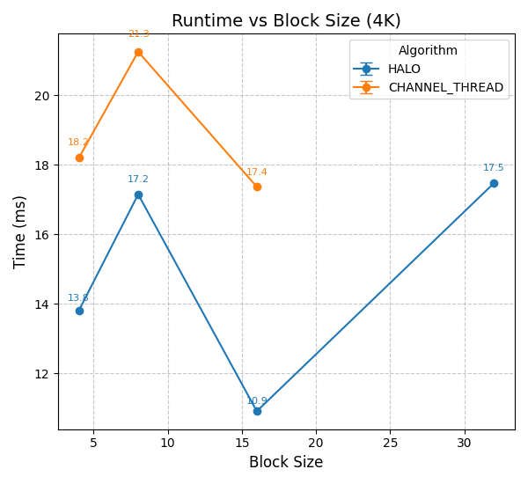
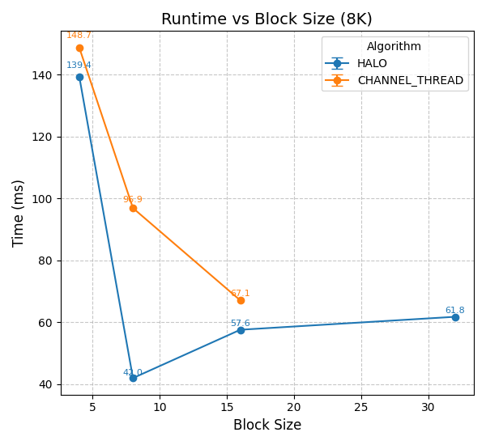
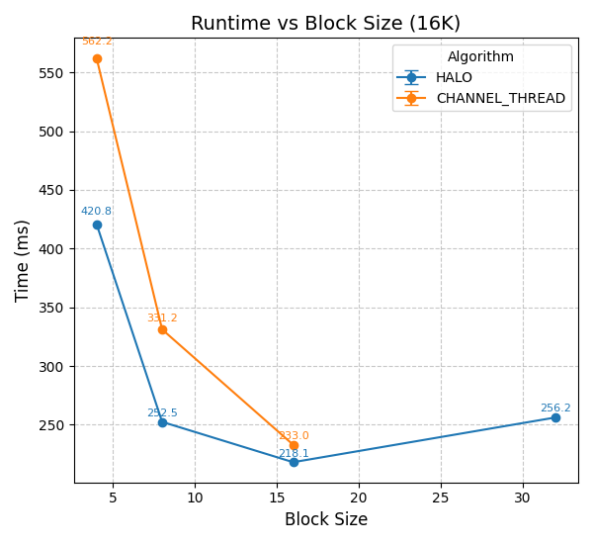
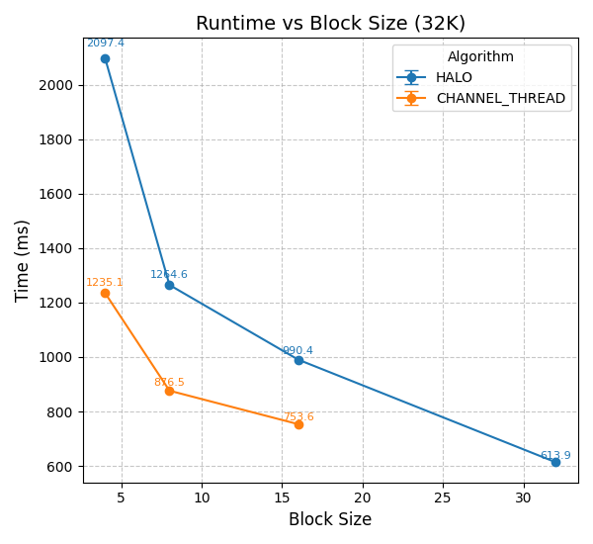
Parallelization results
Comparing Code variances
Larger images take more time
HALO vs CHANNEL_THREAD
HALO
performs well on smaller block sizes
Performance starts to flatten or worsen at larger blocks (memory inefficiencies or global memory reuse limits)
CHANNEL_THREAD
slower overall, especially on smaller images
scales better on large images

Slide 39
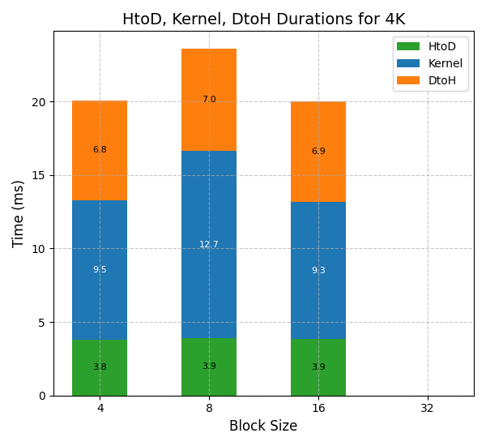
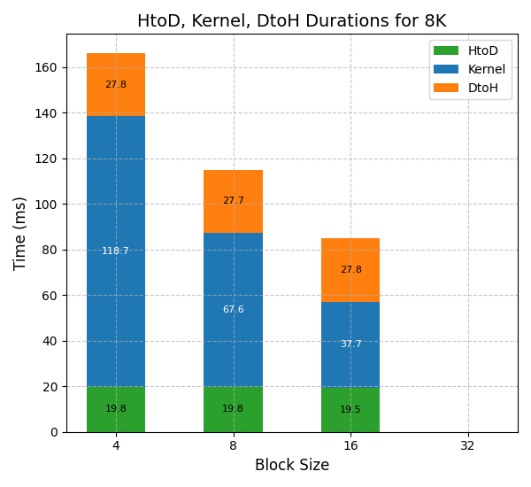
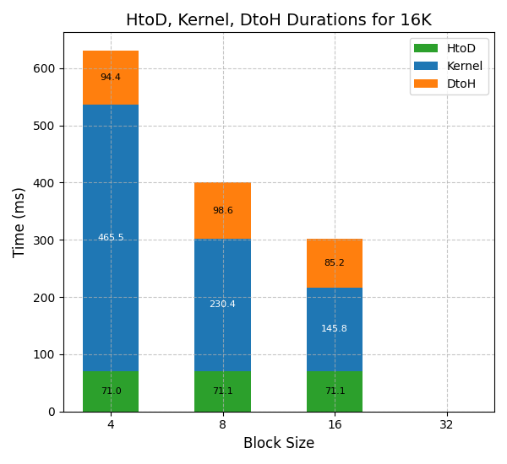
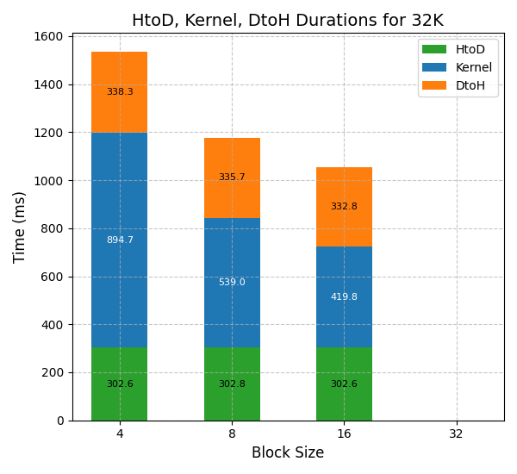
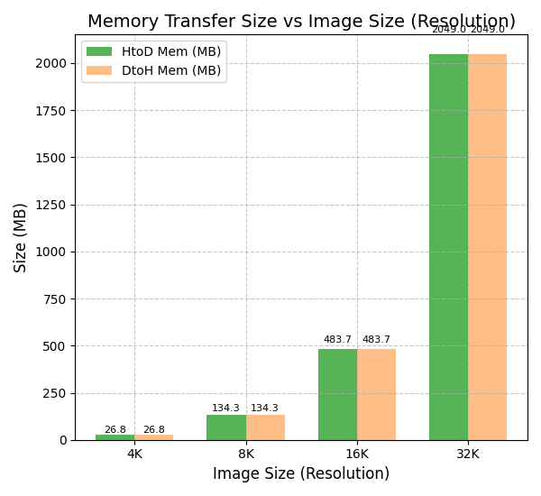
Parallelization results
Cuda detailed (on Channel Thread)
HtoD and DtoH durations independent of the block size or the algorithm used
It only dependent on the image size (resolution)
In order to achieve better overall duration we have to also consider parallelizing the memory allocation functions

Slide 40
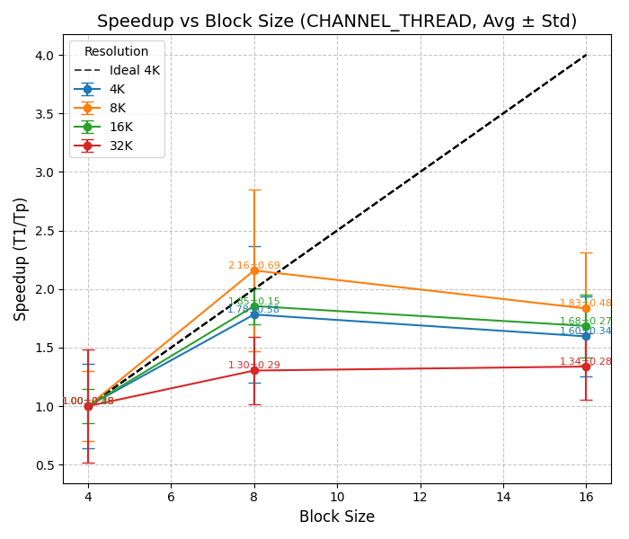
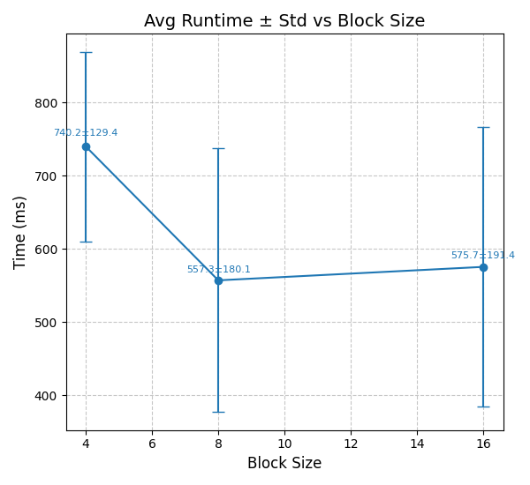
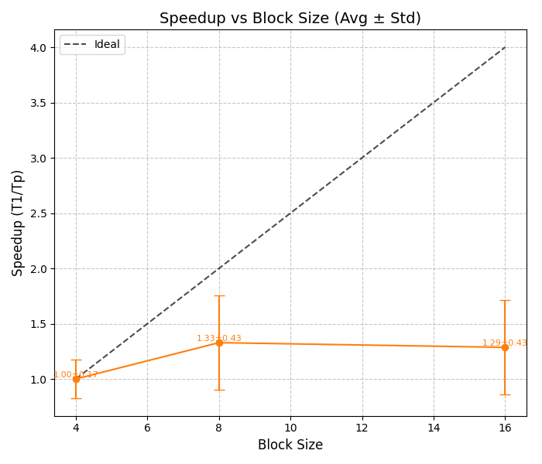
Parallelization results
Statistic (on Channel Thread with 5 runs)
Multiple Resolutions Profiling
“pexels-christian-heitz” Profiling
Block Size | Conclusion
4x4 | Highly unstable. Lots of kernel launches, overhead. Avoid for large images.
8x8 | Best balance of speed and consistency and stable across all image sizes.
16x16 | Good for large images, but can suffer from variability under load or cache misses
Block size 8 hits the sweet spot between overhead and parallelism.
Too small = overhead; too big = underutilization.

Slide 41
Conclusion
Other advancements:
Improvements to the DtoH and HtoD processes (parallelizing)
Does not affect the kernel performance
Memory issues for larger images (serializing the processes by slicing the image)
Kernel time is multiplied by number of slices
A very small block size can cause high overhead
A very large block size may reduce parallel efficiency because fewer blocks are used
There is usually an optimal block size (for example, 8) that offers the best balance between speed and system usage.
This optimal size can vary depending on:
Image resolution
Hardware
The specific implementation of the algorithm

Slide 42
Problem 3: Heat Diffusion Simulation in 2D Grid

Slide 43
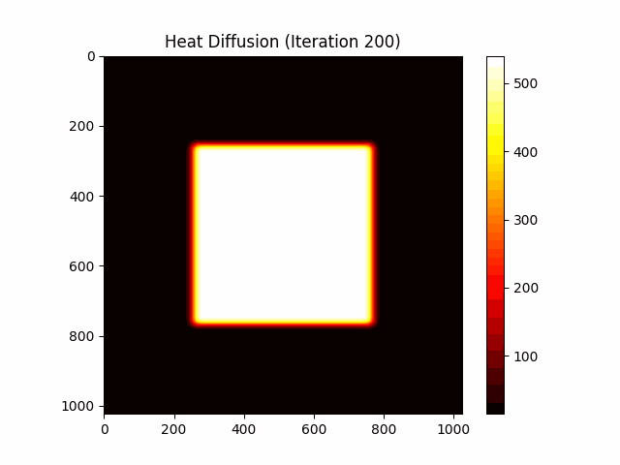
Heat Diffusion - Introduction
Metal plate modeled as 2D grid
Finite Difference Method (FDM)
Each cell = temperature value
Update until convergence or max. iterations
Two cases: isotropic & anisotropic

Slide 44
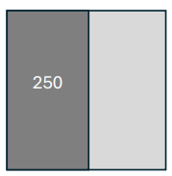
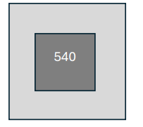
Heat Diffusion - Problem Setup
Grid size: 1024×1024
Mode 0: 50% hot, average rest
Mode 1: 25% hotter core
Update: 4 neighbors
Anisotropic: Wx, Wy

Slide 45
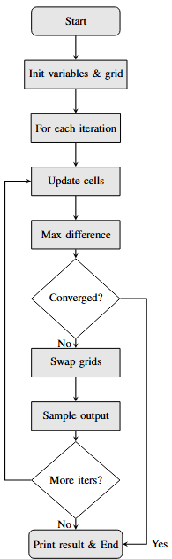
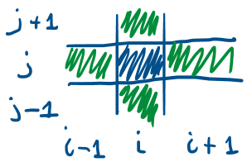
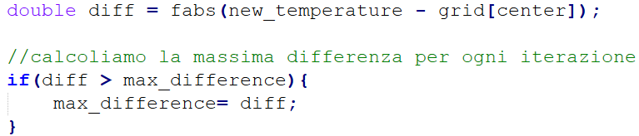
Heat Diffusion - Serial Code Main Idea
“One iteration updates each cell based on neighbors.”

Slide 46
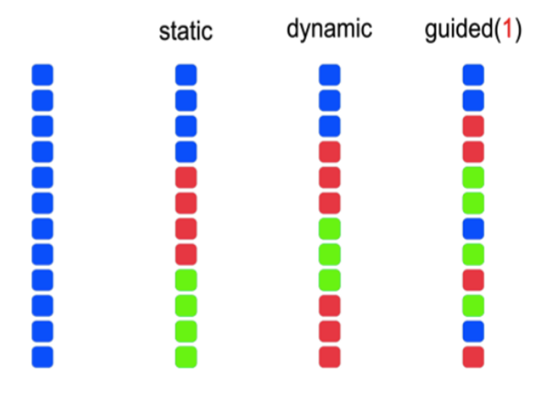
Heat Diffusion - Parallelization
OpenMP used for intra-node parallelism
Parallel for with collapse(2) → N^2
Static schedule since workload per cell uniform
Reduction for max difference
Master thread handles output

Slide 47
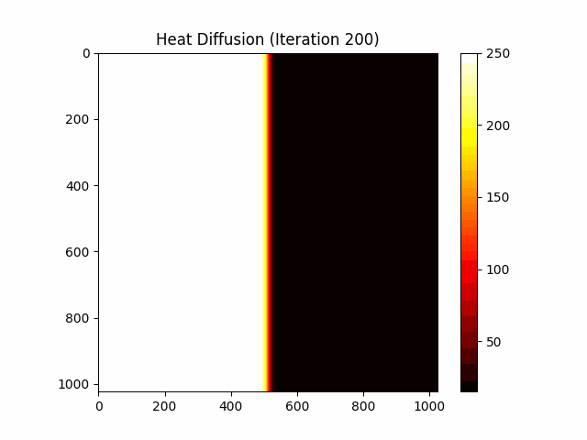
Heat Diffusion - Visualization

Slide 48
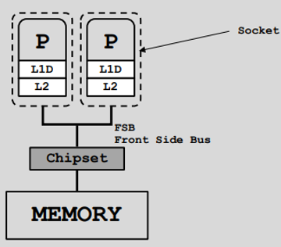
Data Analysis - Experimental Setup
===== lscpu ===== cpu_sapphire* (default)
Architecture: x86_64
CPU(s): 96
Thread(s) per core: 2 Core(s) per socket: 24 Socket(s): 2
Shared-memory only → No inter-node
Checked cores using cpu_check.sh with lscpu
Threads tested: 1 to 96 → 5 runs per config → average
Time: omp_get_wtime()
CPU usage: time command → Usage factor: CPU time / real time

Slide 49
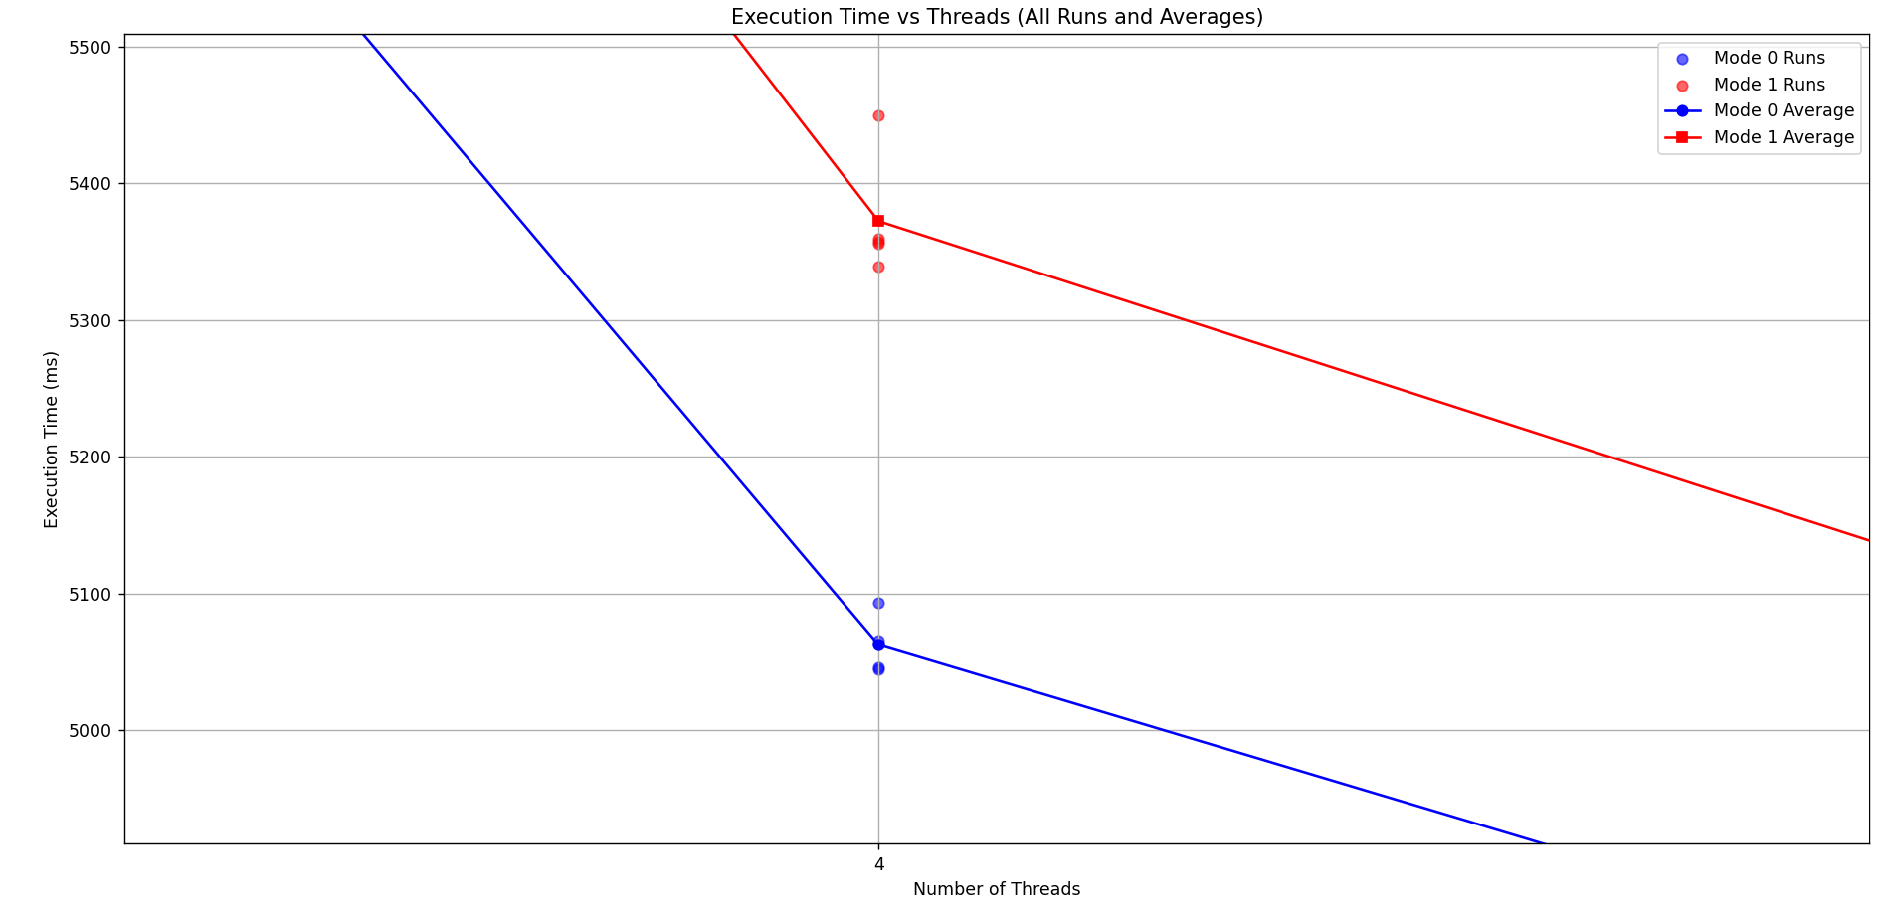
Data Analysis - Random Variations
Observed variations between runs are minimal
During tests HPC provided stable and consistent conditions

Slide 50
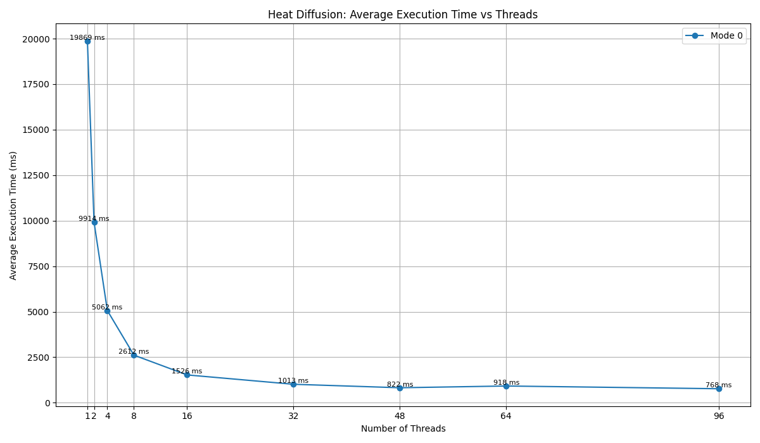
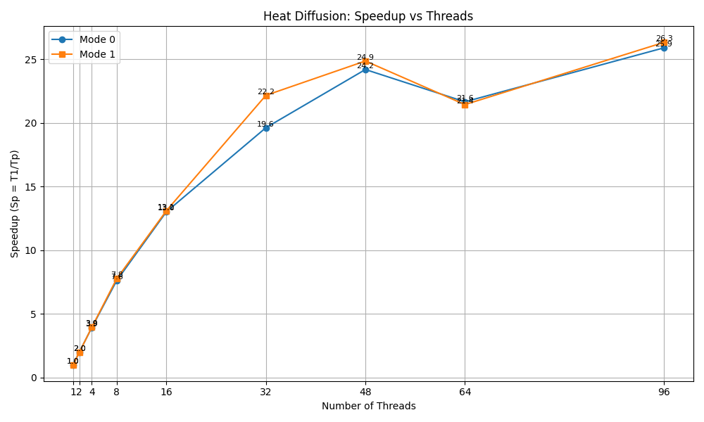
Data Analysis - Time & Speedup
Average time drops as threads grow
Improvement saturates after 32
Same trend: Mode 0 & 1
Speedup: Sp = T1 / Tp
Drop in speedup beyond 48 threads

Slide 51
Data Analysis - Scaling Limits & Bottlenecks
Ideal: speedup doubles with threads
Good scaling up to 32
After 32 → saturation
After 48 → slight drop concurrently with Hyper Threading (HT)*
Possible causes: overhead, sync, diminishing workload per thread
*HT = Hyper-Threading may reduce perf for memory-bound tasks (stencil computations)

Slide 52
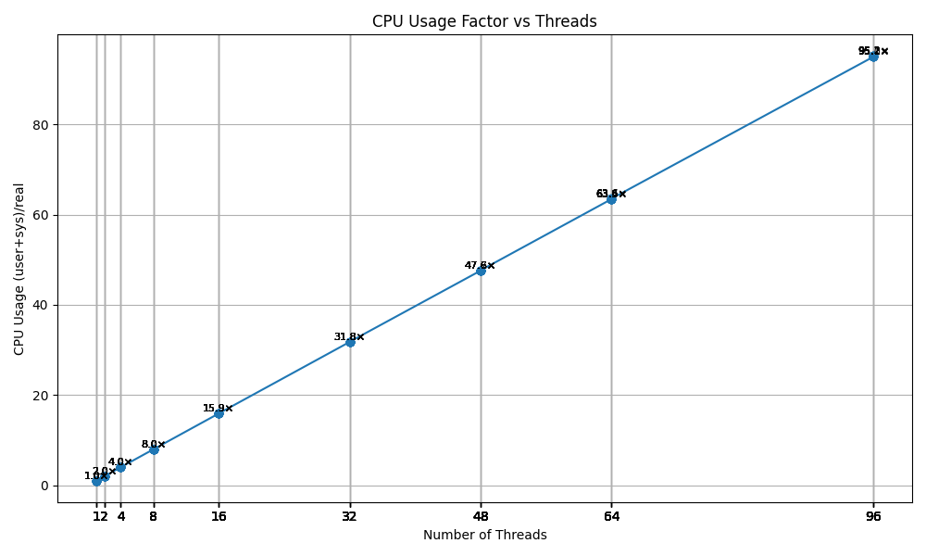
Data Analysis - CPU Usage Factor
== Resource Usage ==
real 1m24.633s
user 1m24.490s
sys 0m0.009s
Measured with time command
Usage = (user + sys) / real
Shows cores kept busy
Usage factor ≈ thread count
Speedup limited by overheads*
*Overheads: sync & memory bandwidth

Slide 53
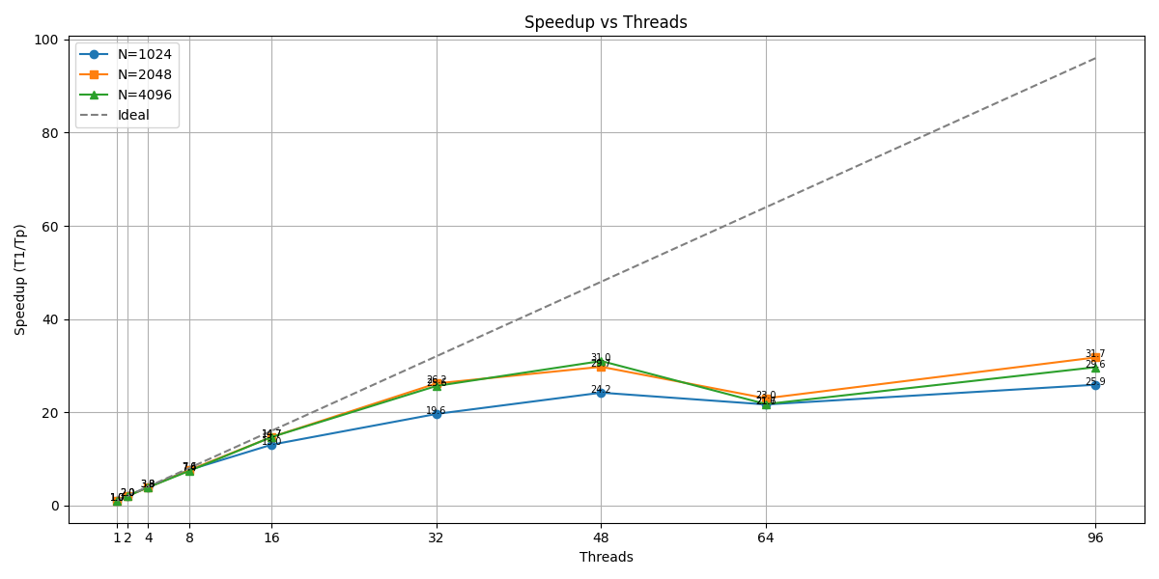
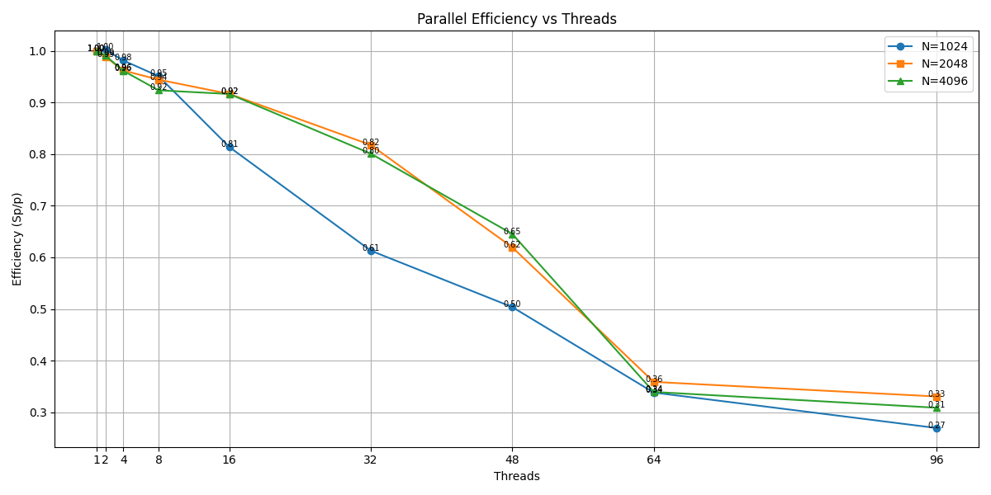
Data Analysis - Larger Grid
Larger grid → more work per thread
Reduces overhead impact
Parallel efficiency: Ep = Sp / p
Test: 2048 → 15 minutes, 4096 → hours
Result: higher speedup, better efficiency

Slide 54
Data Analysis - Conclusions
Larger grid → a bit better scalability
Higher work-to-overhead ratio
Shared-memory limits visible
2048 grid: best trade-off between scaling & runtime
Hybrid approach needed for more (MPI+OpenMPI)

